Slide 1

www.pei.cmha.ca

Slide 2
CMHA Rapid Housing Initiative
Early November 2020 – CMHC launches the Rapid Housing initiative to create jobs, support economic recovery and eliminate chronic homelessness in Canada.
Late November 2020 – CMHA PEI approached by the Department of Social Development and Housing (DSDH) re our interest in exploring this opportunity. The funding could only be accessed by municipalities, NGO’s and Indigenous governing bodies. The project must utilize modular components in the build and be completed by December 2021.
Early December 2020 – CMHA PEI (John) sources a design team with extensive experience in modular builds. 720 Solutions are based in Calgary and were quickly able to determine that the modular build capacity in Atlantic Canada was nil for a Dec 2021 deadline. They sourced capacity in the Prairies that could meet the RHI timeframe.
December 2020 – meetings with 720 Solutions, 9 yards Architects, DSDH staff and CMHA PEI to finalize preliminary design, budget, and application details.

Slide 3
Timeline
Dec 31, 2020 – Application submitted for 33 units with ground floor commercial space.
Early January 2021, in partnership with DSDH, CMHA PEI was able to secure funding for the purchase of the land at 203 Fitzroy St.
Mid-February 2021, notification received that the application was unsuccessful.
Late March 2021 – confirmation received from DSDH that they wish to proceed with a scaled down version of the project, with a financial contribution similar to their share of the RHI application. CMHA PEI reviews the scaled down project’s financial viability without federal funding, determines it is viable and agrees to proceed. The project will now contain 20 units with commercial space for CMHA PEI.

Slide 4
Timeline
Early April 2021 – Weekly meetings commence with CMHA PEI, 720 Solutions, 9 Yards Architects, Leading Edge as the general contractor, and various consultants. Without the RHI deadline of December 2020, 720 Solutions sources Kent Factory Homes as the supplier of the modular units. Kent indicates they can deliver the units to PEI in February of 2022, with the building completed by June 2022. Sourcing the units in the Maritimes saves $700,000 in shipping from the original budget.
Weekly meetings held to ultimately have shop drawings ready for August 2021.
Early July 2021 – Round 2 of RHI announced; deadline is August 31 and only those entities who applied in December 2020 are eligible for this second round. Discussions with DSDH conclude that CMHA PEI will scale the project back up for this second round. Design is re-worked to add another 8 units, bringing the total units to 28.

Slide 5
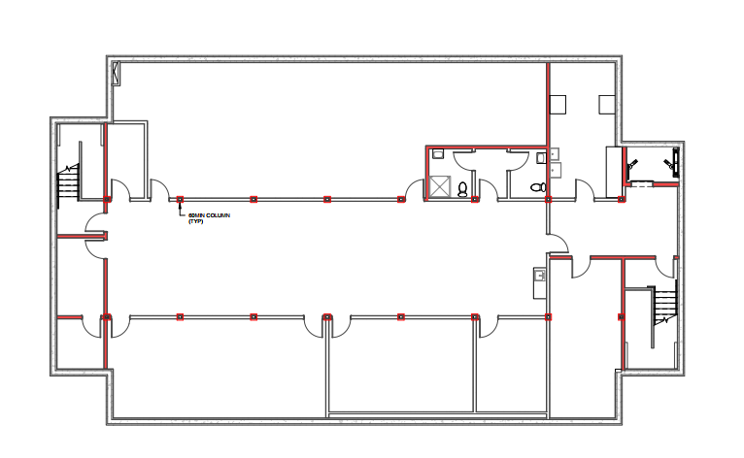
Design

Slide 6
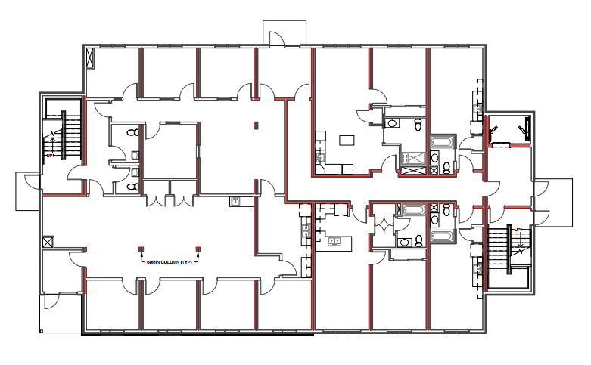
Design

Slide 7
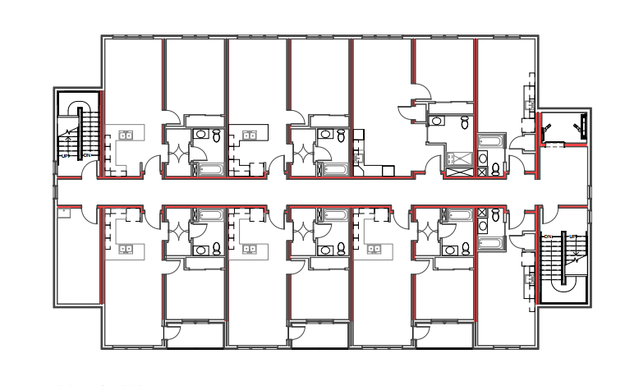
Design

Slide 8
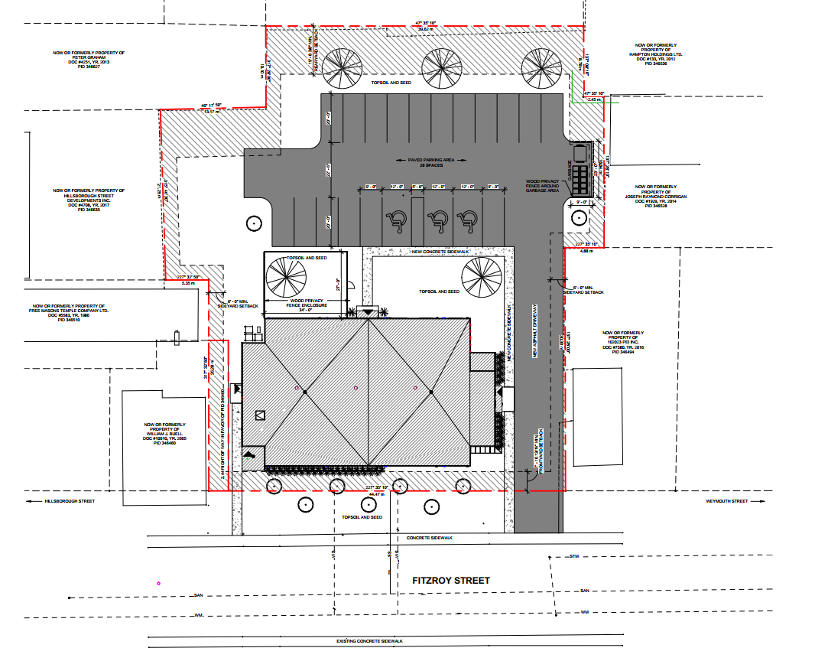
Design

Slide 9
Timeline
Late August 2021 – with the additional 8 units and a fourth floor, a height variance is required from the City of Charlottetown Planning Review Board, and City Council. Approval received and building permit applied for.
August 31, 2021 – Application submitted for 28 units with ground floor commercial space, and a full basement for meeting and storage space.
October 19, 2021 – Day trip for a site visit to the Kent Factory in Bouctouche, NB by staff from 720 Solutions and 9 Yards, along with John, Shelley, and Fitzroy Centre housing staff, Rob Nelson and Faruk Can.
October 21, 2021 – meeting with Holland College staff to inquire re a partnership to document the build and possibly provide students with practical learning opportunities in the areas of journalism, project management, carpentry, etc.
December 1, 2021 – Estimated date as to when the RHI contracts for successful applicants will be signed.

Slide 10
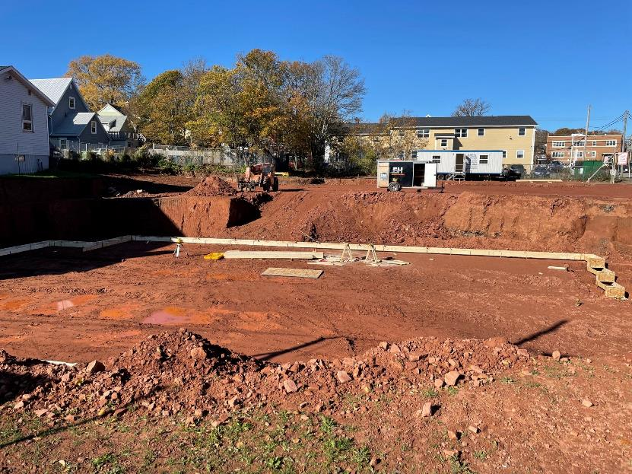

Slide 11
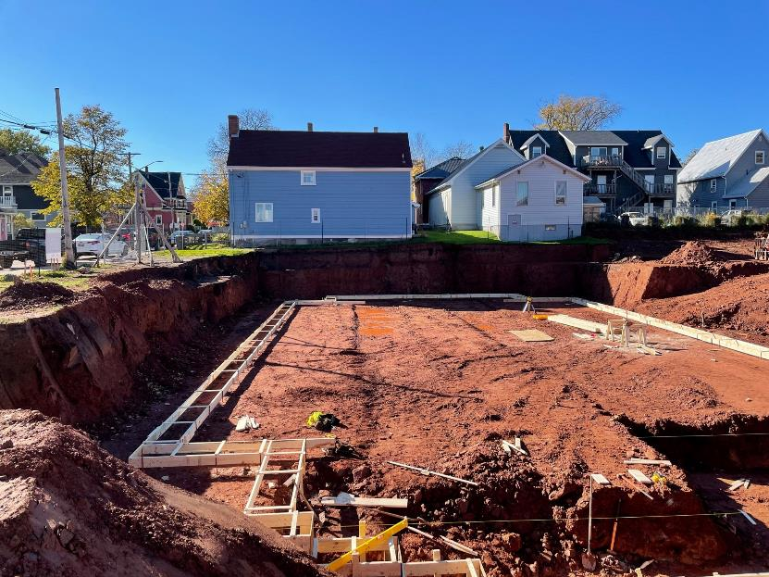

Slide 12
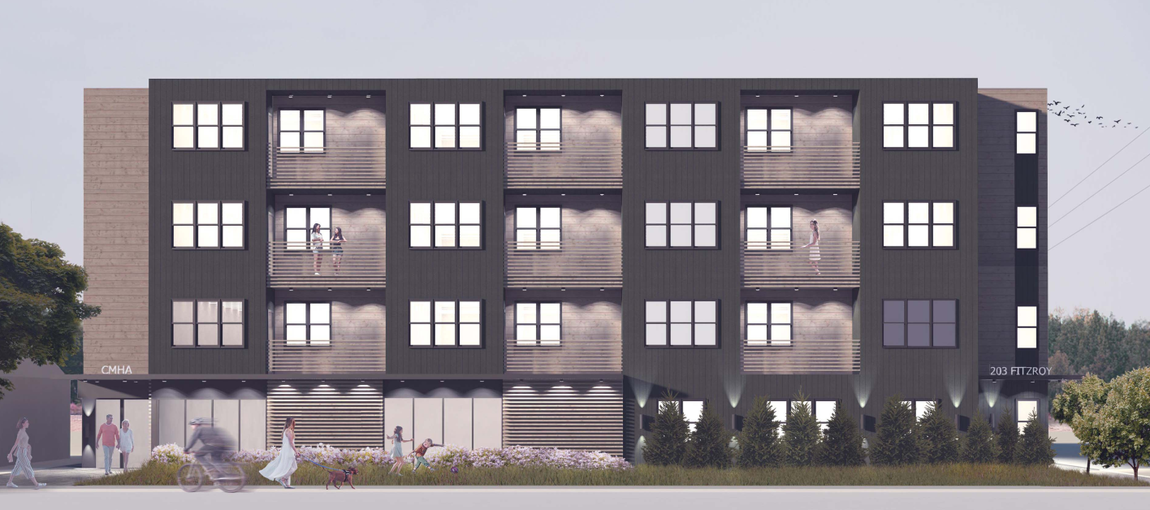
203 Fitzroy Street
Target Occupancy July 2022

